Slide 1
The Economic Machinery

Slide 2

What is Economy and why to study it?
General Definition
Economics is the study of how humans make decisions in the face of scarcity. These can be individual decisions, family decisions, business decisions or societal decisions. If you look around carefully, you will see that scarcity is a fact of life
Financial Point of View
The simple answer is it affects our everyday lives through important areas such as tax, interest rates, wealth, and inflation

Slide 3
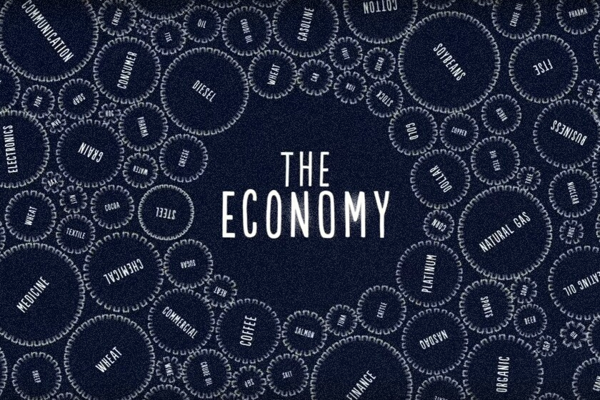
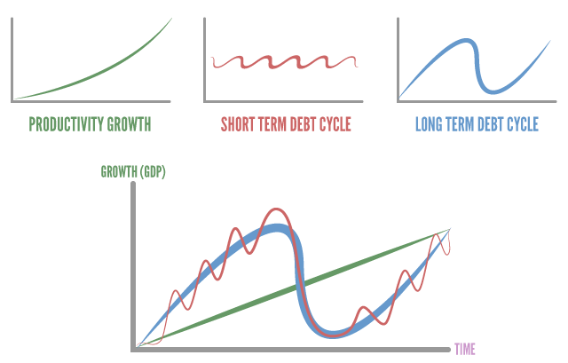
Looks Complex but works in a simple mechanical way.
Smallest building block being a transaction.
These transactions gets repeated over and over a million times.
Repetition of transactions cause 3 main things:
Productivity Growth
Short Term Debt Cycle
Long Term Debt Cycle
The Economic Cycles

Slide 4
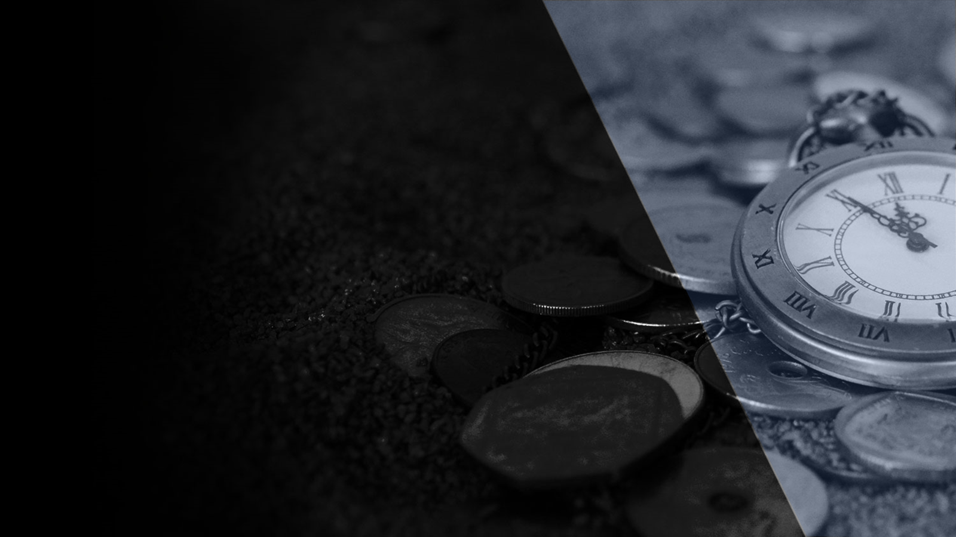

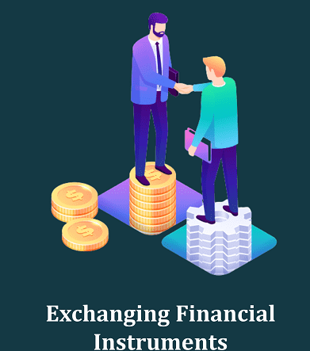
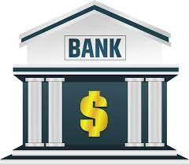
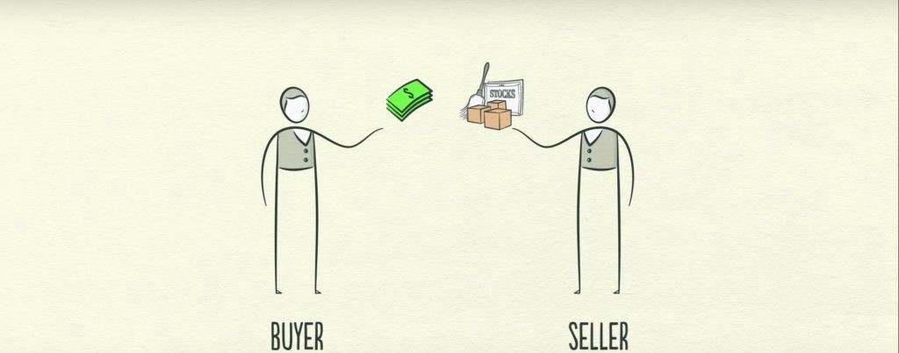
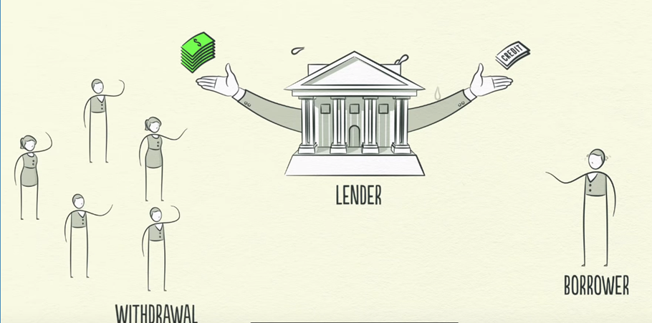
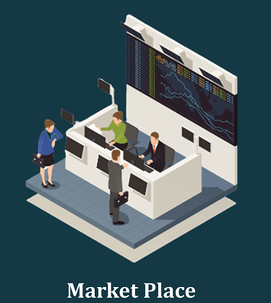
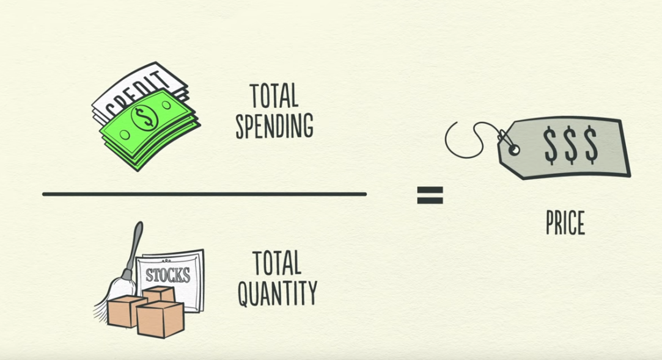

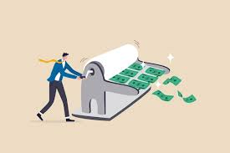
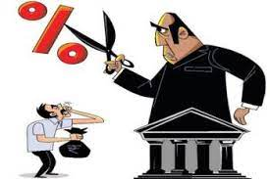
Money Lending
Government
Market
Transactions
Money lending is the act of loaning money to another person or company
2 key players
Lenders
Lend money to make more of it
Borrowers
borrow money to buy something which they cant afford like house , car etc..
All buyers and sellers making transactions represent the market.
It’s a common place for them to meet and exchange goods & Services.
Based on the different product / commodity , markets are of various types like wheat market , stock market , steel market, oil market etc.
Government ( Biggest Player)
Central Government
Spends Money
Collects Taxes
Central Bank
Controls Flow of Money in Economy
Controls Interest Rate
Transactions are essentially the exchange of money or credit between a buyer and seller for goods, services or financial assets. This is how individuals, businesses, banks and Government all operate.
Price is simply the result of total spending / quantity sold.
Transactions are the building blocks of the economic machine.
If you understand how transactions work, you understand the whole economy.
The economy is simply the sum of all transactions in it.

Slide 5
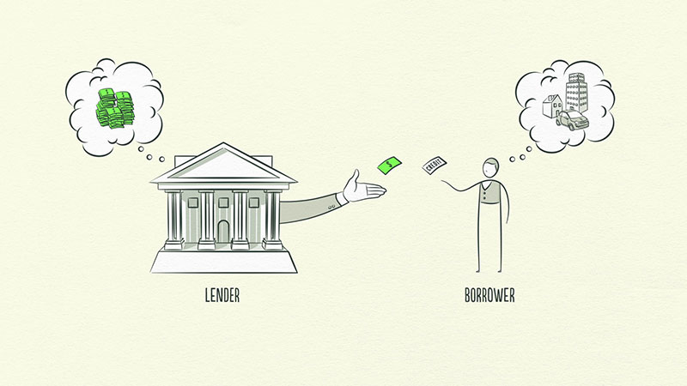
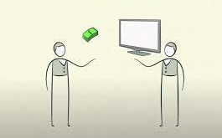
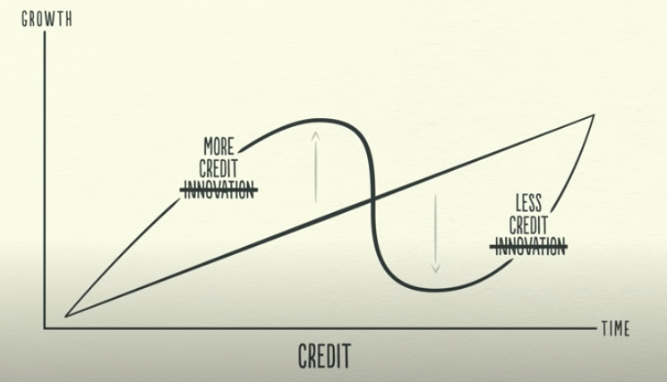
What is Credit?
What is Debit?
Trust for one party to provide resources to another party
No immediate reimbursement but a promise is made to repay at later date ( ~Borrowed Money (Principle) + Interest = Final Amount)
Biggest and most Volatile part of economy.
Whenever credit is issued , it turns into debt.
Credit for Lender ( Asset)
Debit for Borrower ( Liability)
Transaction settled in future when money repaid with interest.
Credit Debit

Slide 6
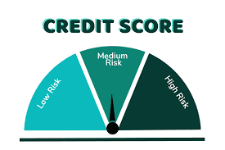
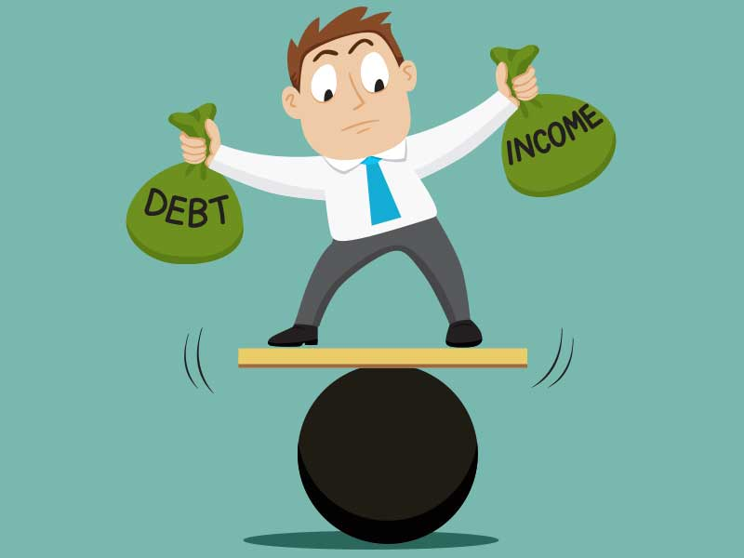
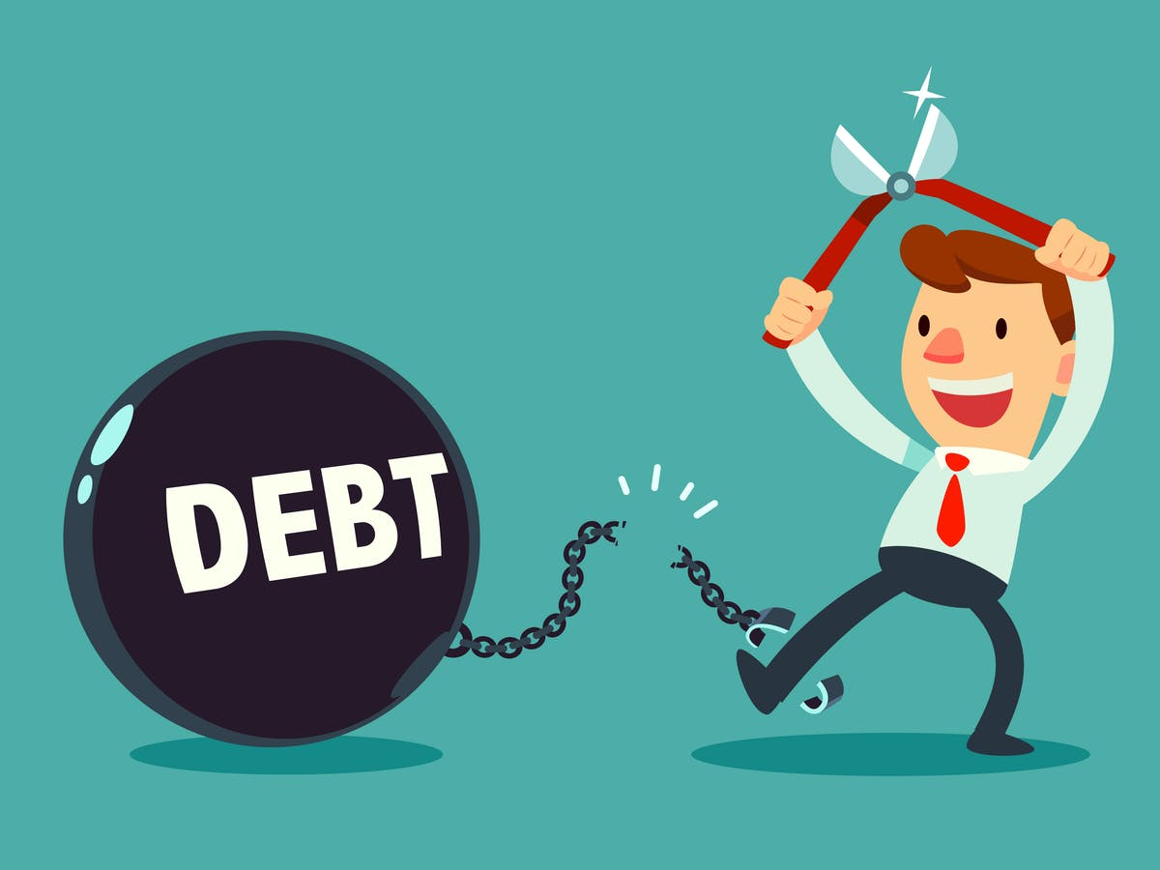


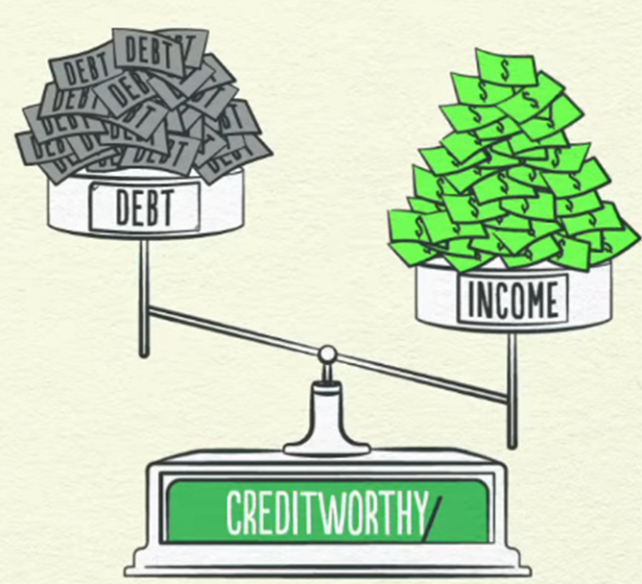
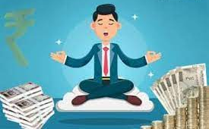

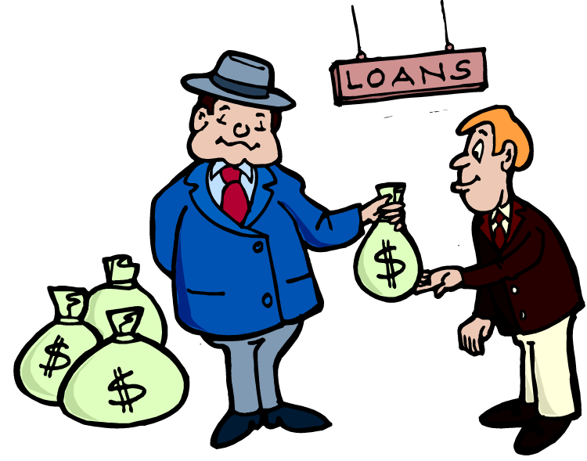
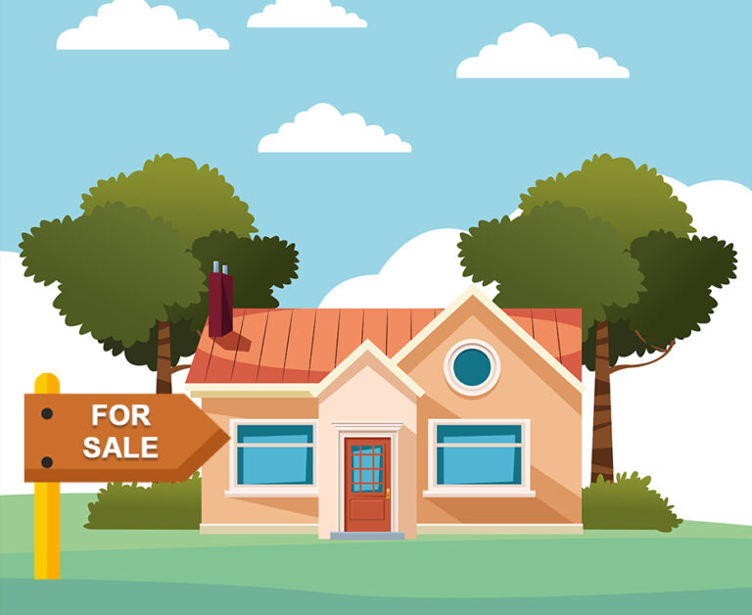

The Cycle Continues..
With higher credit score , you borrow more as Bank provides a lower interest rate.
People spend more as purchasing power increases
Income Increase
Credit Score
Borrow More
Credit Worthy Borrower
Rich
Metric used by financial institutions like banks indicating whether you are likely to repay anything you borrow based on your credit history

Slide 7
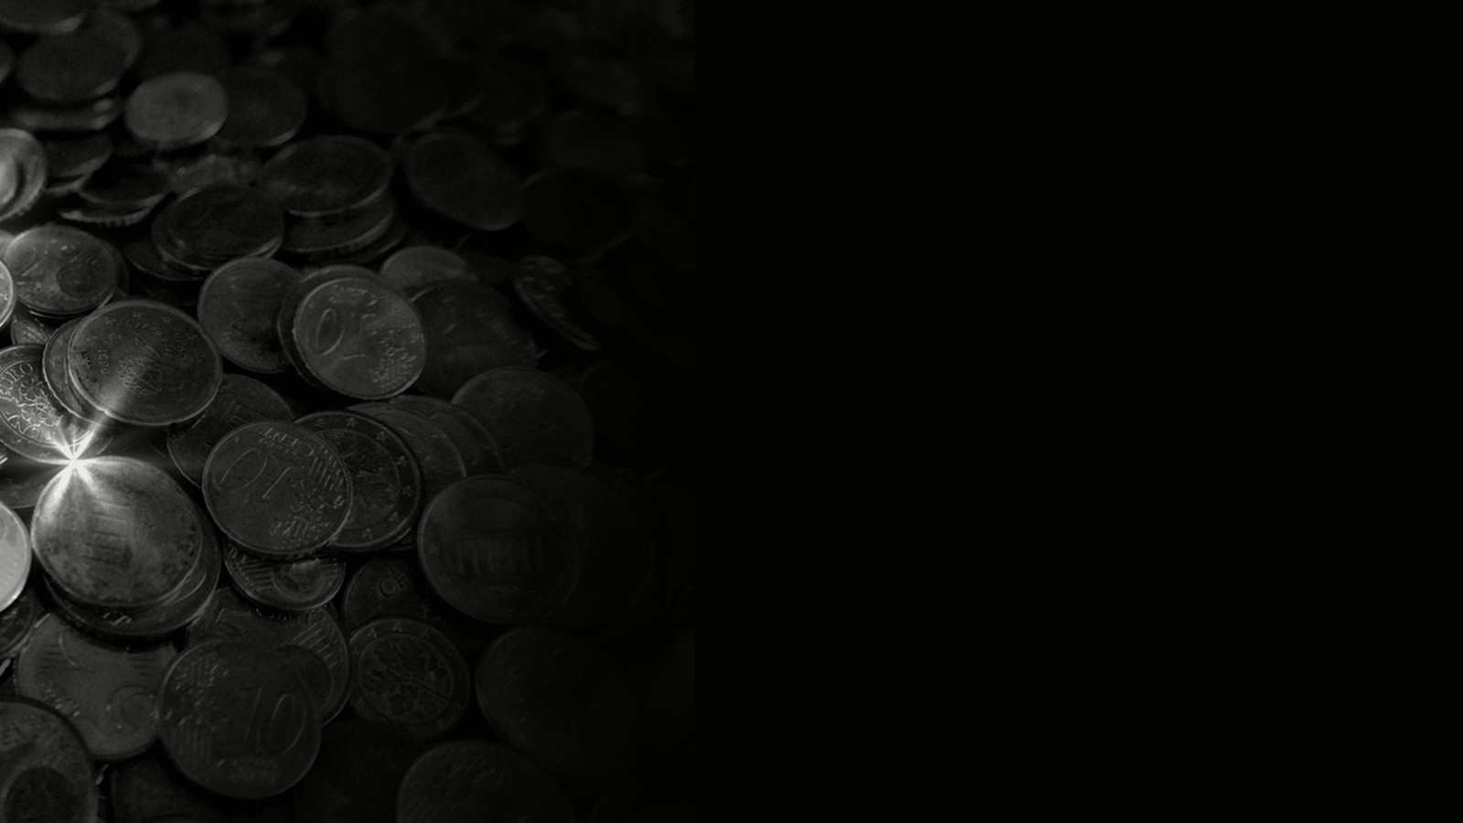
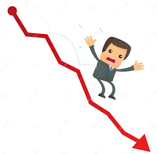
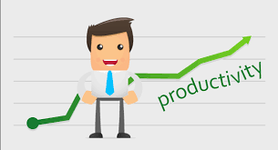
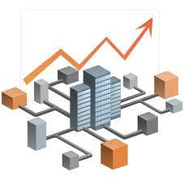
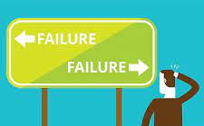
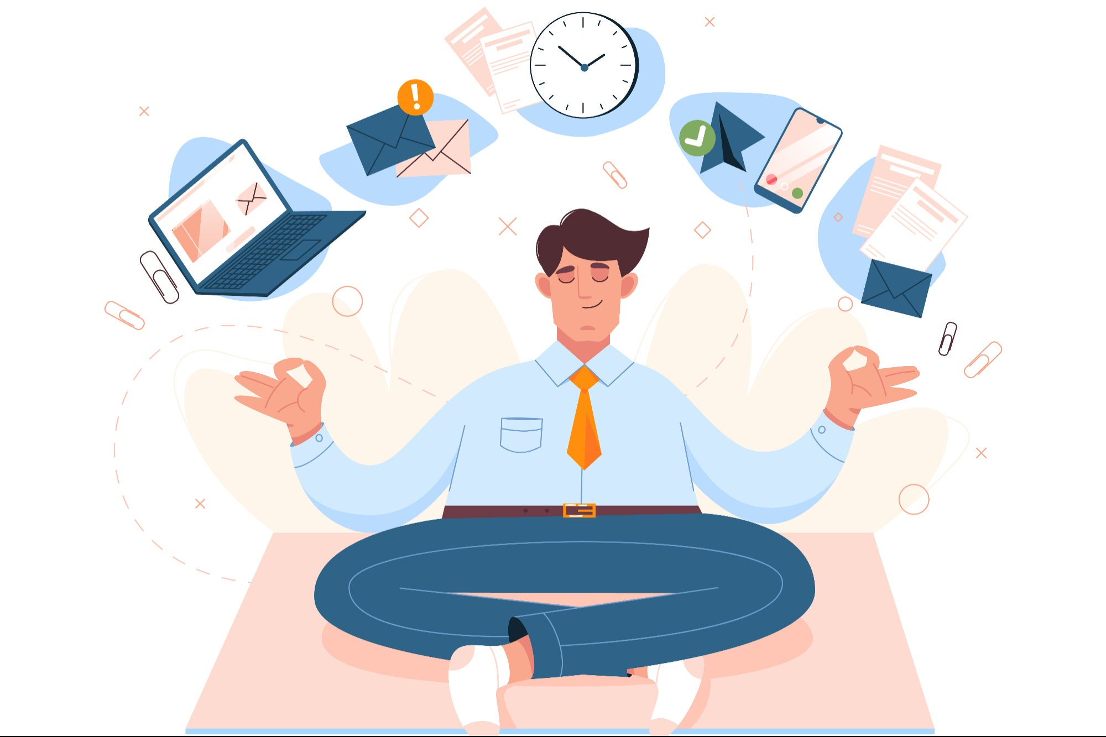
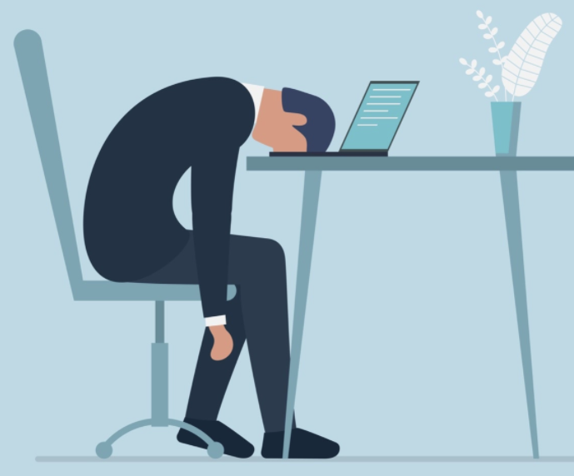
Productivity Growth
Produce More
Less Production
With increase in production , we are able to sell more .
Production is less , hence selling decreases , leading to less supply , less demand
Business Expansion
High
Low
Business Decline
In time business expands due to continuous increase in Production
Depreciation in company value ,
Share price reduces
Better Managers
Inactive Workforce
Fast Learner
More intuitive
Proactive
Intellectual Slothism
Sluggish
Procrastination

Slide 8
Debt Swing
Debt allows us to consume more than we produce when it is acquired, and forces us to consume less when we have to pay it back
Productivity growth doesn’t fluctuate much so it’s not big driver of economic swings.
You make mistake , you learn and improvise
Most people don’t really see it because they are living day by day, week by week
Productivity matters in long run, but credit matters in the short run.

Slide 9

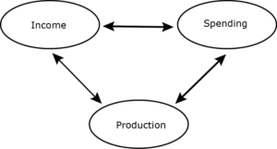
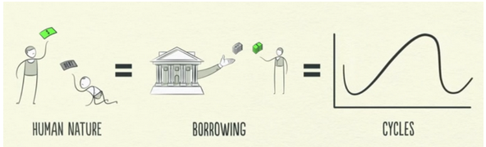
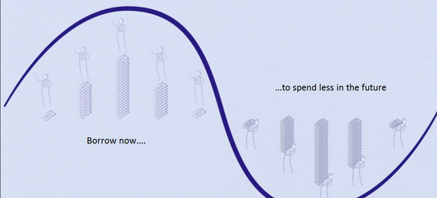
Do we really need credit?
Lets think of economy without credit ( runs only through money that flows in it).
Only way to increase income is to increase productivity.
What are the downsides of such economy?
Slower production because of no credit/borrowing
Human nature of dissatisfaction and greed leads to borrowing overtime
If lenders are offering cheap money to allow us live beyond our means, we’ll take it, consequences be damned.
But in order to buy things you can’t afford today, you need to pull your spending forward from the future. You’re basically borrowing from your future self.

Slide 10
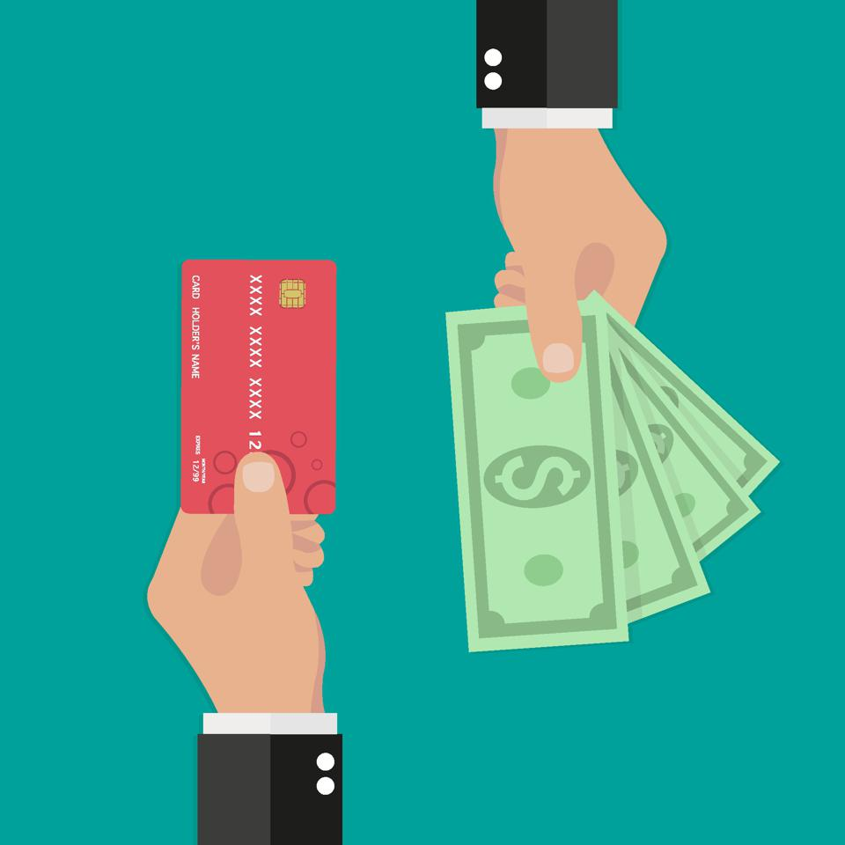
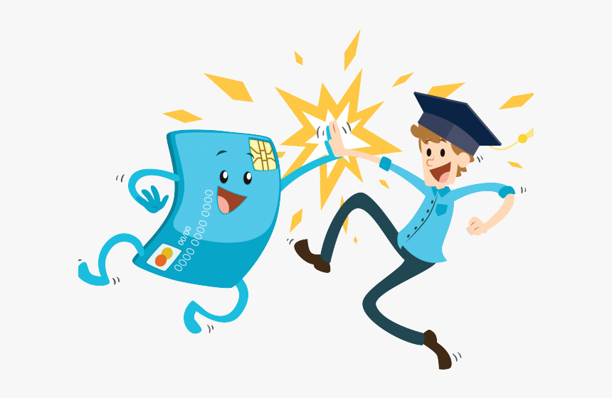
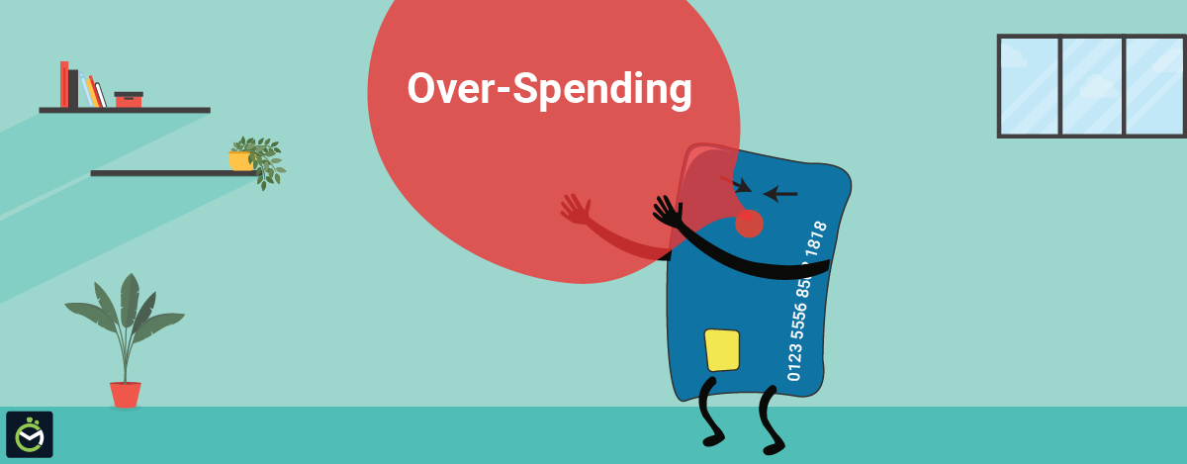
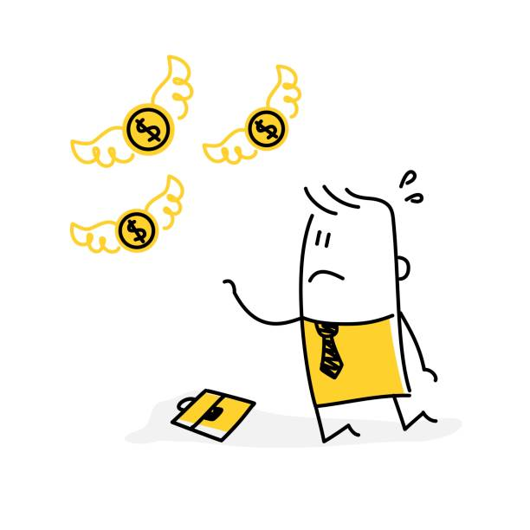
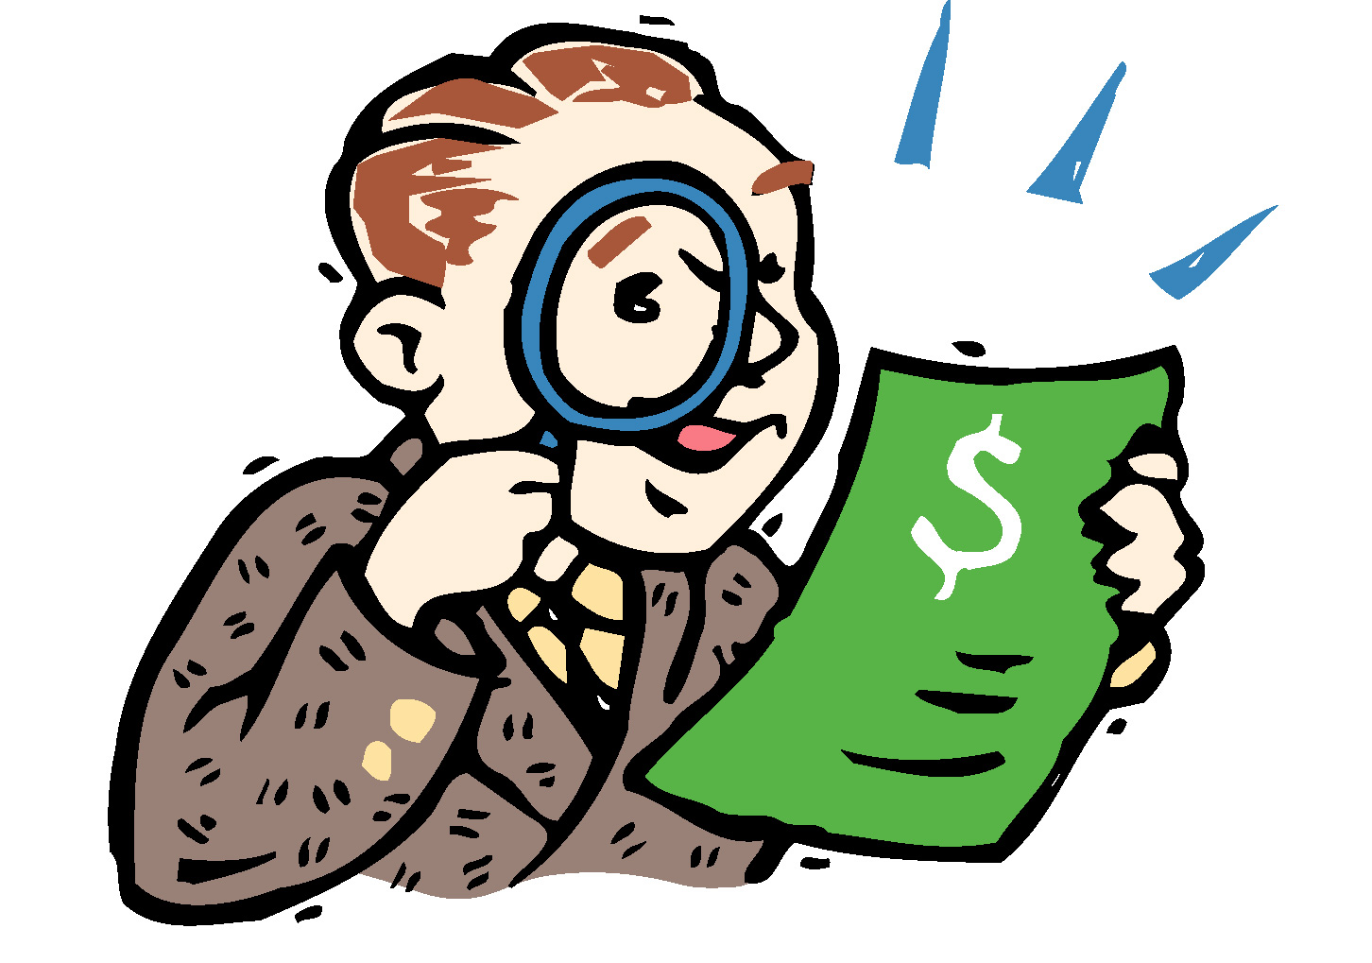
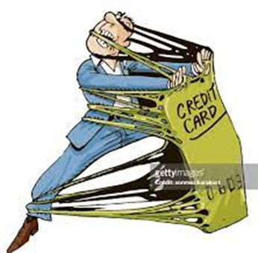
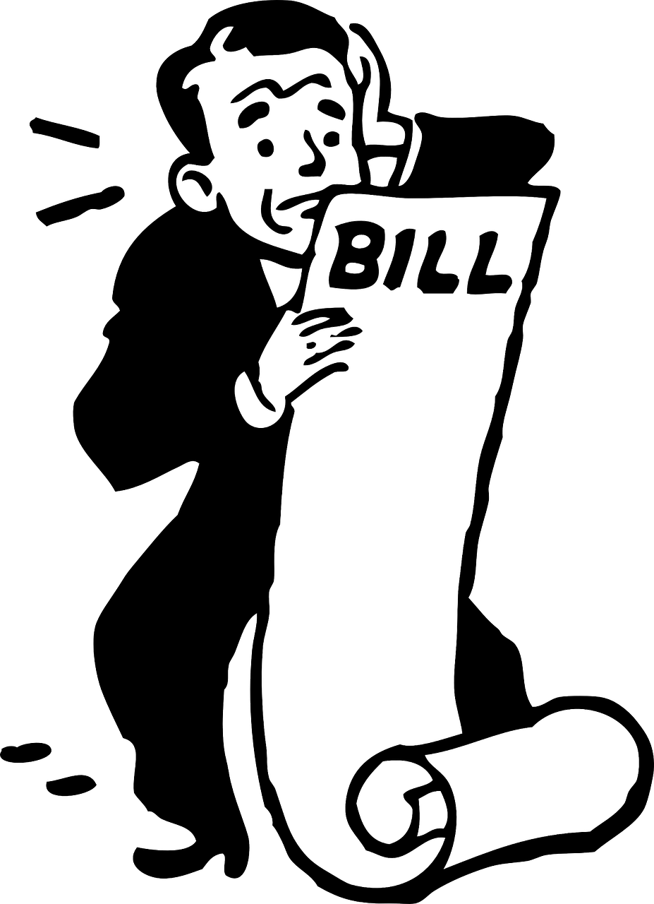
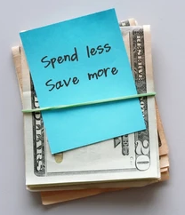
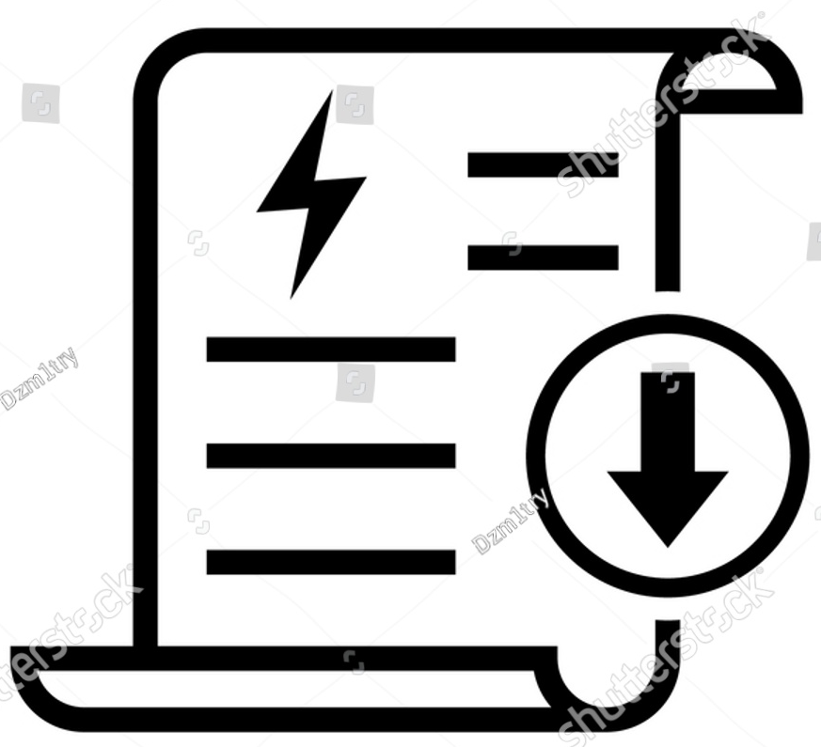
M
O
N
E
Y
V
S
C
R
E
D
I
T

Slide 11
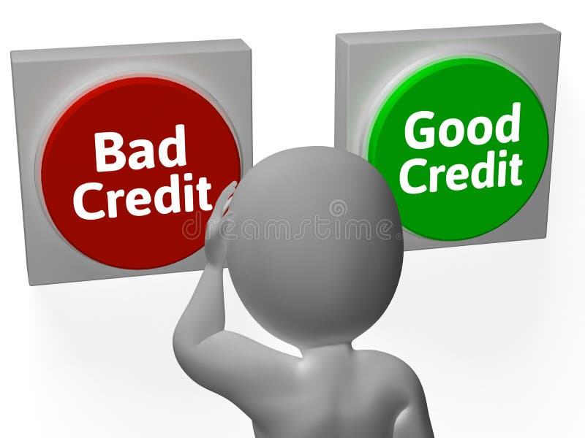

Slide 13
Productivity Growth
High Productivity
Add Contents Title
Get a modern PowerPoint Presentation that is beautifully designed. I hope and I believe that this Template will your Time, Money and Reputation. Easy to change colors, photos and Text. You can simply impress your audience.
Get a modern PowerPoint Presentation that is beautifully designed. I hope and I believe that this Template will your Time, Money and Reputation. Easy to change colors, photos and Text. You can simply impress your audience.
ALLPPT Layout Clean Text Slide
ALLPPT Layout Clean Text Slide
Modern PowerPoint Presentation
Modern PowerPoint Presentation
Easy to change colors, photos and Text.
Easy to change colors, photos and Text.
ALLPPT Layout Clean Text Slide
ALLPPT Layout Clean Text Slide
Modern PowerPoint Presentation
Modern PowerPoint Presentation
Easy to change colors, photos and Text.
Easy to change colors, photos and Text.

Slide 16
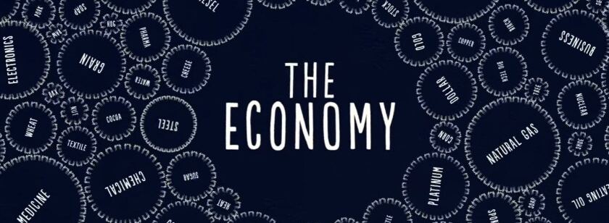
Looks Complex but works in a simple mechanical way. Smallest building block being a transaction. These transactions gets repeated over and over a million times.
Repetition of transactions cause 3 main things:
01
Productivity Growth
02
Short Term Debt Cycle
03
Long Term Debt Cycle

